Slide 1
LBPL Mini Project -1
Python game on Linux (Ubuntu) using Oracle Virtualbox
Name: Shreerang Mhatre
Roll no: 29
Batch: A2
PRN: 1032211745

Slide 2
Turtle Crossing Game
This is a Turtle Crossing Game done on Python and performed on Linux using Virtual box. We have used python and Tkinter library. For the gui we have used the turtle class from Tkinter. This game is more a gui game than a command prompt game.
For this we have made 4 modules:
Main.py
Car_manager.py
Player.py
Scoreboard.py
All these modules have different tasks to perform and made so in order to avoid confusion.
Following are the screenshots of the entire program.

Slide 3
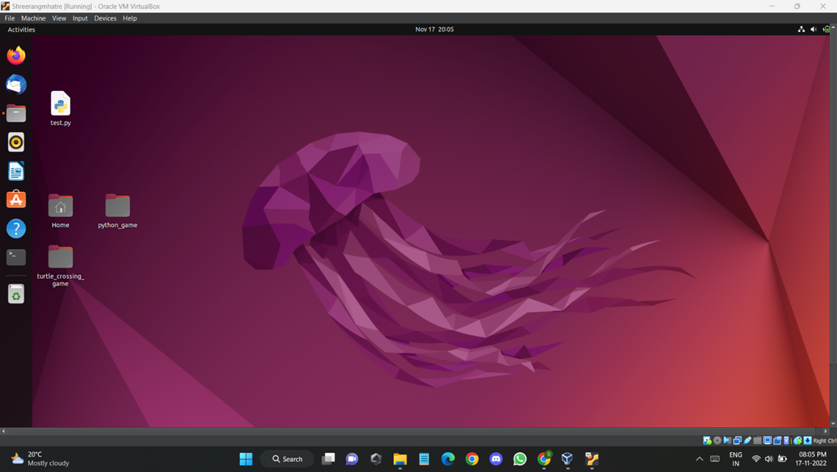

Slide 4
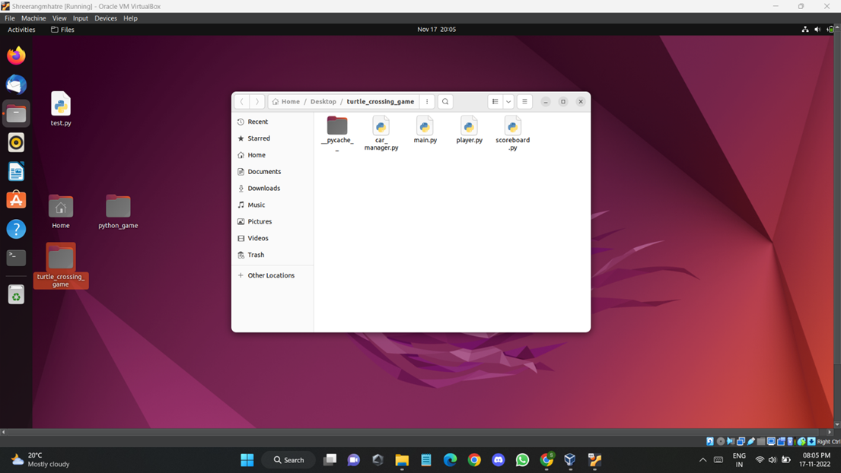

Slide 5
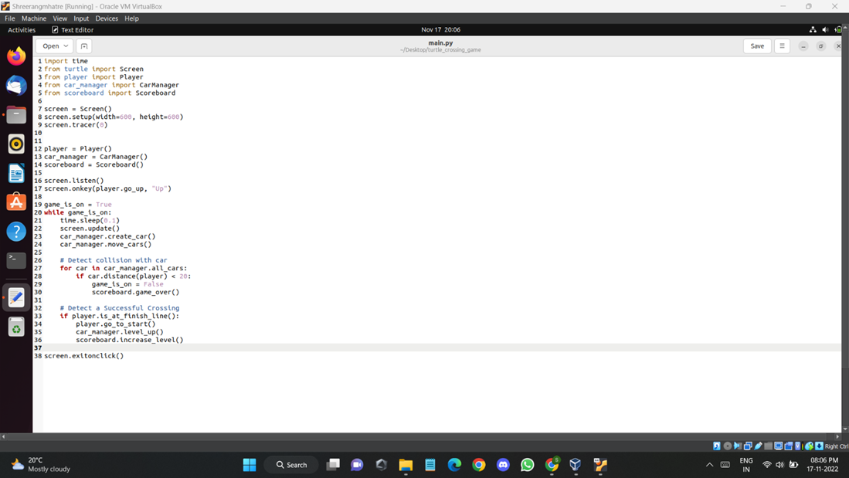

Slide 6
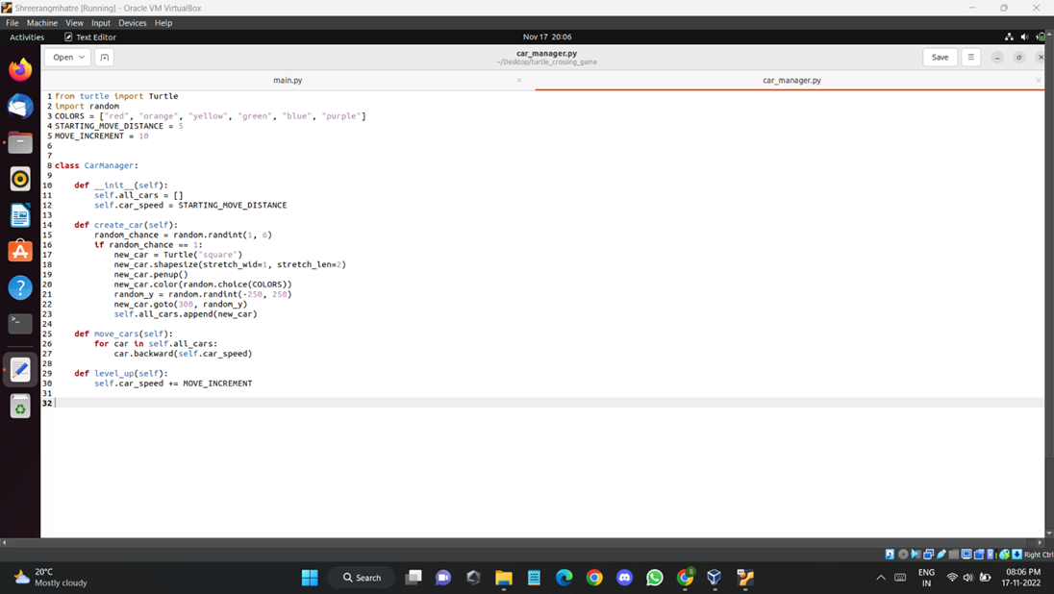

Slide 7
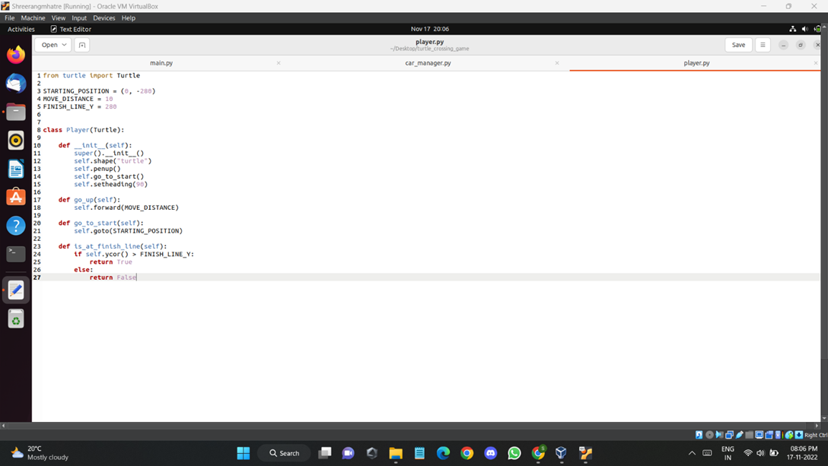

Slide 8
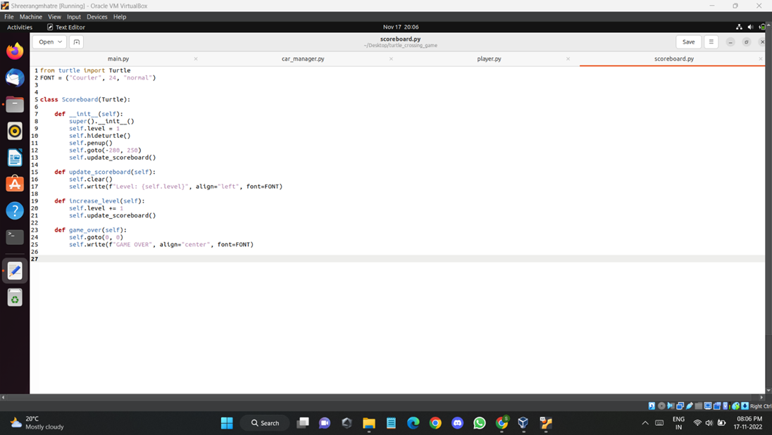

Slide 9
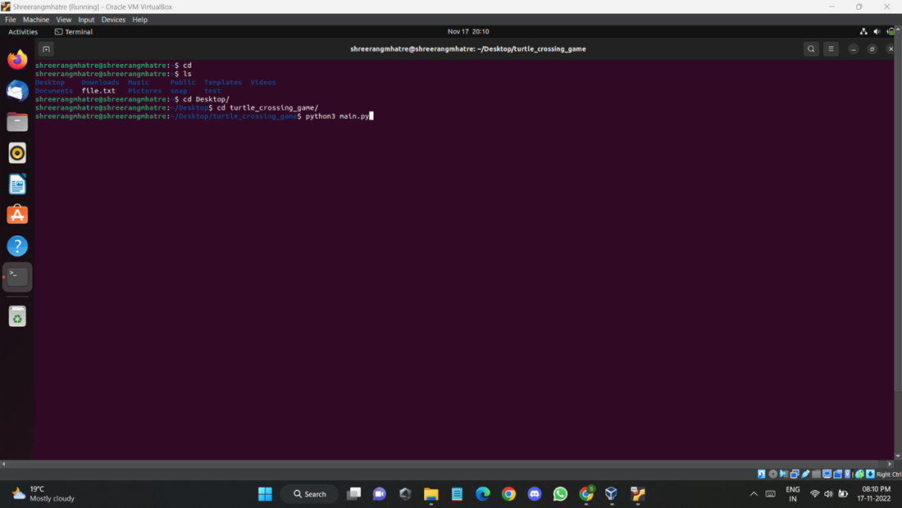

Slide 10
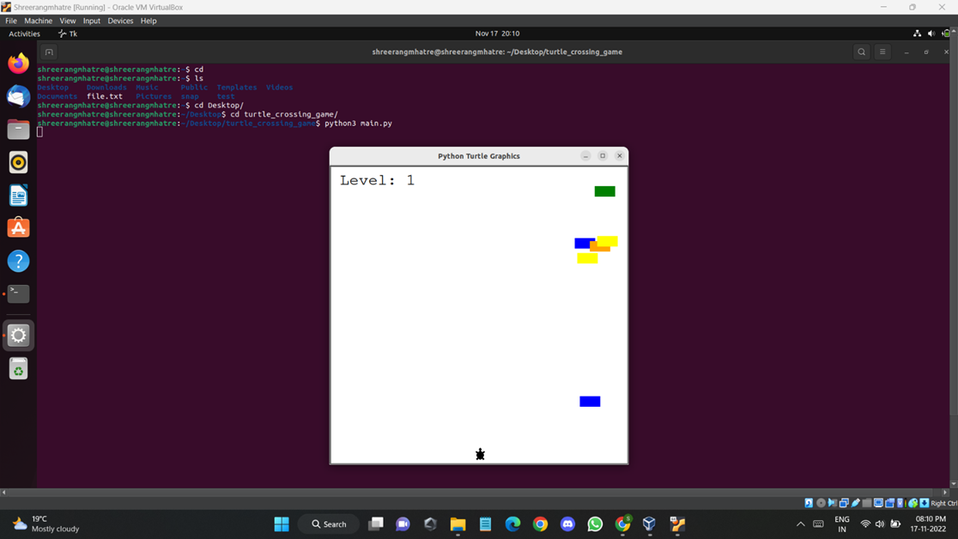

Slide 11
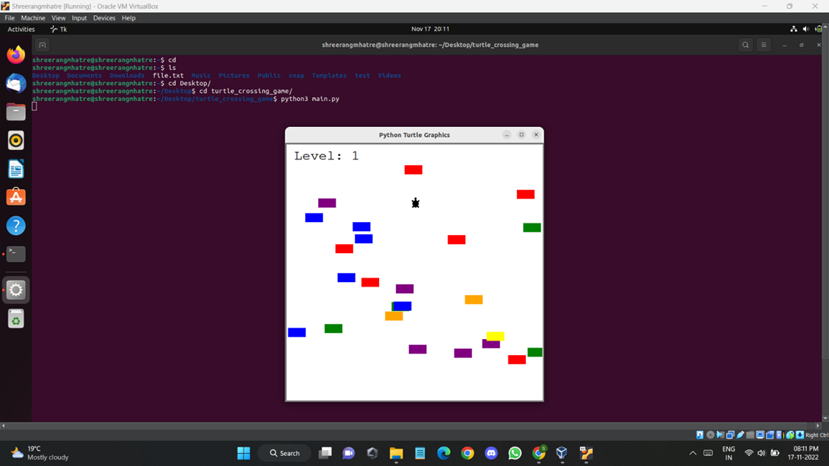

Slide 12
